Slide 1
INDONESIA
By : Adrianus Bannepadang
アドリアナス バネパダン

Slide 2
INDONESIAN MAP

Slide 3
INTRODUCTION
The Indonesian archipelago has been an important trade region since at least the 7th century, when Sriwijaya and then later Majapahit traded with China and India.
Indonesian history has been influenced by foreign powers drawn to its natural resources. Muslim traders brought Islam, and European powers brought Christianity and fought one another to monopolize trade in the Spice Islands of Maluku during the Age of Discovery.
Indonesia's history has since been turbulent, with challenges posed by natural disasters, corruption, separatism, a democratization process, and periods of rapid economic change.

Slide 4
HISTORY
The early, modern history of Indonesia begins in the period from 2500 BCE to 1500 BCE with a wave of light brown-skinned Austronesian immigrants, thought to have originated in Taiwan
The first Europeans to arrive (after Marco Polo who passed through in the late 1200s) were the Portuguese, who were given permission to erect a go down near present-day Jakarta in 1522.
The British occupied Java from 1811 to 1816, and as a result Indonesians still drive on the left.
In 1824, the Dutch and the British signed the Anglo-Dutch Treaty which divided the Malay world into Dutch and British spheres of influence, with the Dutch ceding Malacca to the British, and the British ceding all their colonies on Sumatra to the Dutch.
During World War II, the Japanese conquered most of the islands. In August 1945 in the post war vacuum following the Japanese surrender to allied forces the Japanese army and navy still controlled the majority of the Indonesian archipelago. The Japanese agreed to return Indonesia to the Netherlands but continued to administer the region as the Dutch were unable to immediately return due to massive destabilization from the effects of war in Europe.

Slide 5
GEOGRAPHY
Indonesia lies between latitudes 11°S and 6°N, and longitudes 95°E and 141°E. It consists of 17,508 islands, about 6,000 of which are inhabited. These are scattered over both sides of the equator. The largest are Java, Sumatra, Borneo (shared with Brunei and Malaysia), New Guinea (shared with Papua New Guinea), and Sulawesi. Indonesia shares land borders with Malaysia on Borneo, Papua New Guinea on the island of New Guinea, and East Timor on the island of Timor. Indonesia shares maritime borders across narrow straits with Singapore, Malaysia, the Philippines, and Palau to the north, and with Australia to the south. The capital, Jakarta, is on Java and is the nation's largest city, followed by Surabaya, Bandung, Medan, and Semarang.

Slide 6
Government and Politics
Indonesia is a republic with a presidential system.
The president of Indonesia is the head of state, commander-in-chief of the Indonesian National Armed Forces, and the director of domestic governance, policy-making, and foreign affairs.
The president appoints a council of ministers, who are not required to be elected members of the legislature.
The 2004 presidential election was the first in which the people directly elected the president and vice president.
The president may serve a maximum of two consecutive five-year terms.

Slide 7
INDONESIAN PROVINCES AND THEIR CAPITALS, LISTED BY REGION

Slide 8
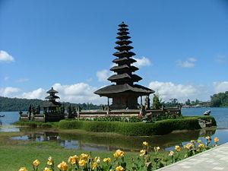
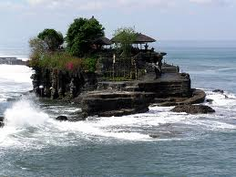
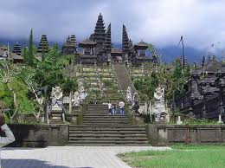
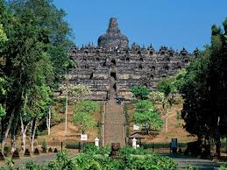
Indonesian Culture
Indonesia has about 300 ethnic groups, each with cultural identities developed over centuries, and influenced by Indian, Arabic, Chinese, and European sources. Traditional Javanese and Balinese dances, for example, contain aspects of Hindu culture and mythology, as do wayang kulit (shadow puppet) performances
The most dominant influences on Indonesian architecture have traditionally been Indian; however, Chinese, Arab, and European architectural influences have been significant. There are two very famous culture in Indonesia which is Bali and Toraja

Slide 9
T a n a To r a j a ( T o r a j a L a n d )

Slide 10
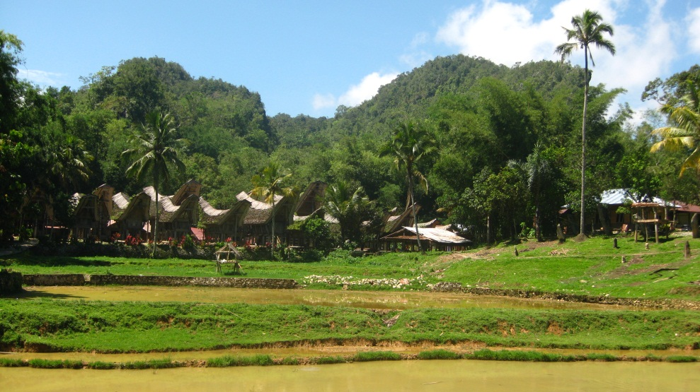
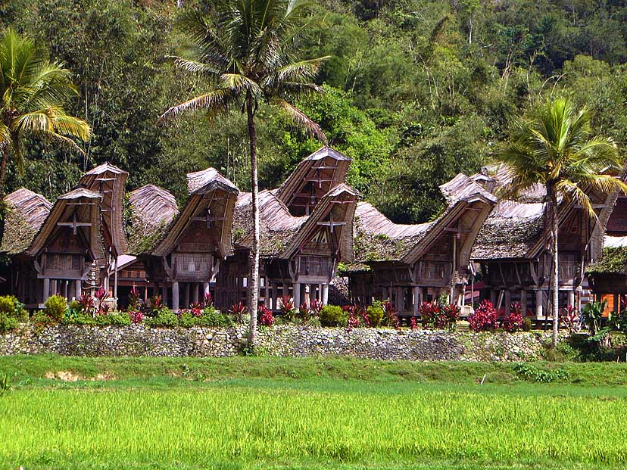
Introduction
Tana Toraja is well known with various natural landscape and tourism objects, such as beautiful mountains view, rice fields with terrace, architecture of Torajan houses and unique culture of its people.

Slide 11
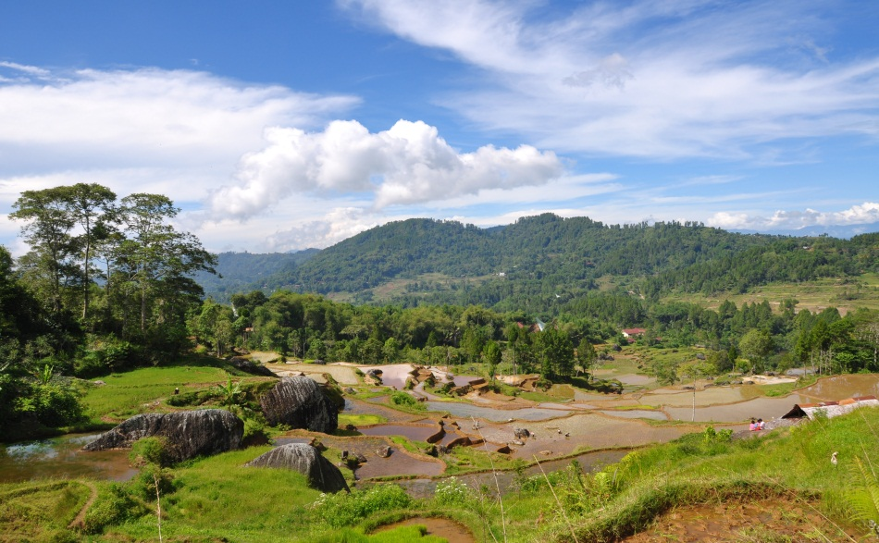
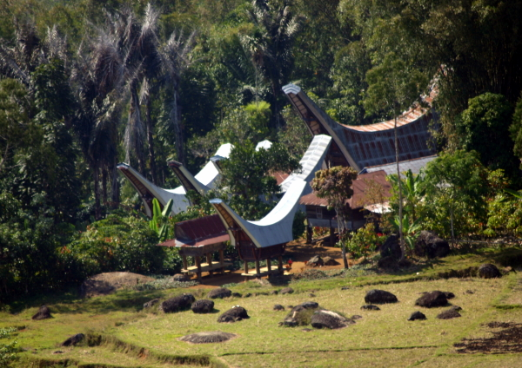
Tana Toraja Climate
Tana Toraja is located in high ground, it has a pleasant climate year around, as well as surrounded by tropical and pine forest. Daily temperature varies from around 16°C in the evening and early morning to around 28°C during the day. This climate makes almost all hotels in Tana Toraja don’t install air conditioner in their rooms.

Slide 12
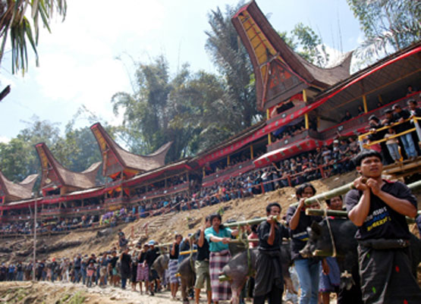
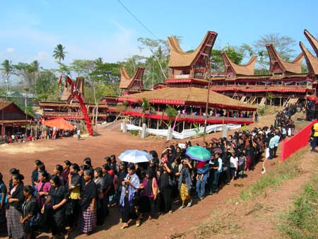
Tana TorajaCulture
Tana Toraja has unique culture like funeral ceremony which has special meaning to the toraja people. Toraja's indigenous belief system is polytheistic animism, called Aluk, or "the way" (sometimes translated as "the law"). In the Toraja myth, the ancestors of Torajan people came down from heaven using stairs, which were then used by the Torajans as a communication medium with Puang Matua, the Creator.

Slide 13
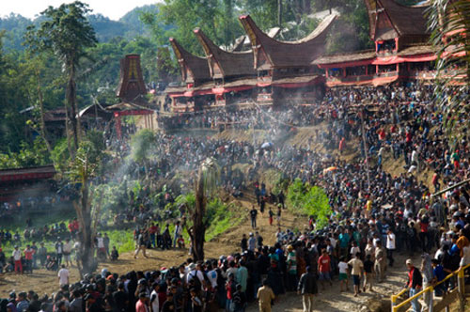
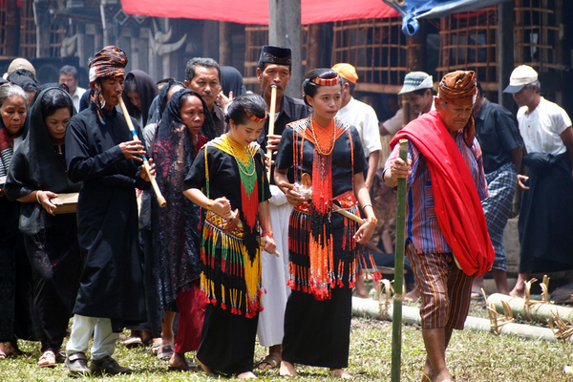
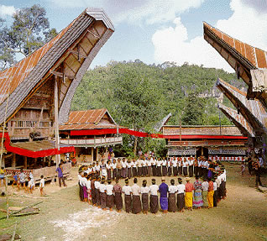
Funeral Ceremony

Slide 14
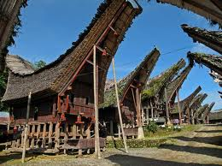
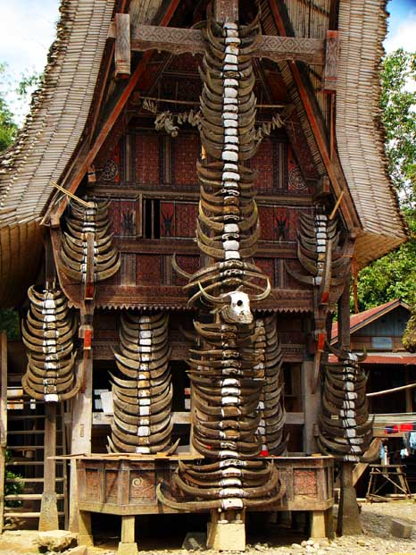
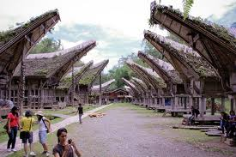
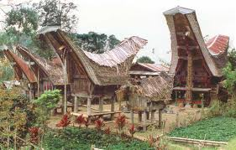
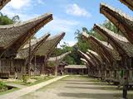
Traditional Torajan Houses

Slide 15
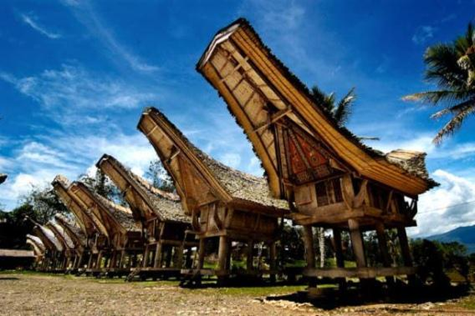
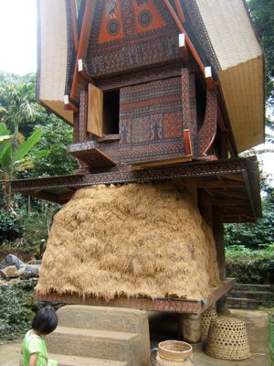
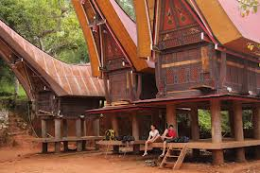
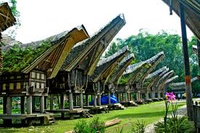
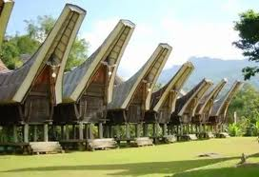
Torajan Rice Barn

Slide 16
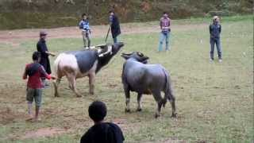
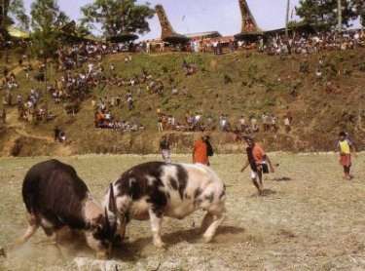
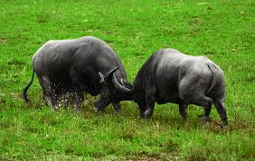
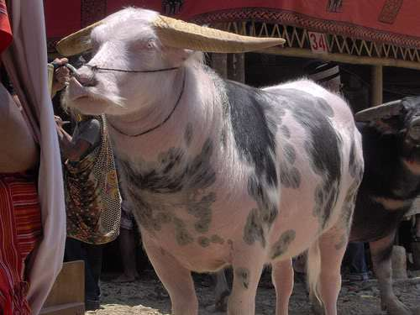
Illegal Logging in Indonesia

Slide 17
Fighting Buffalos

Slide 18
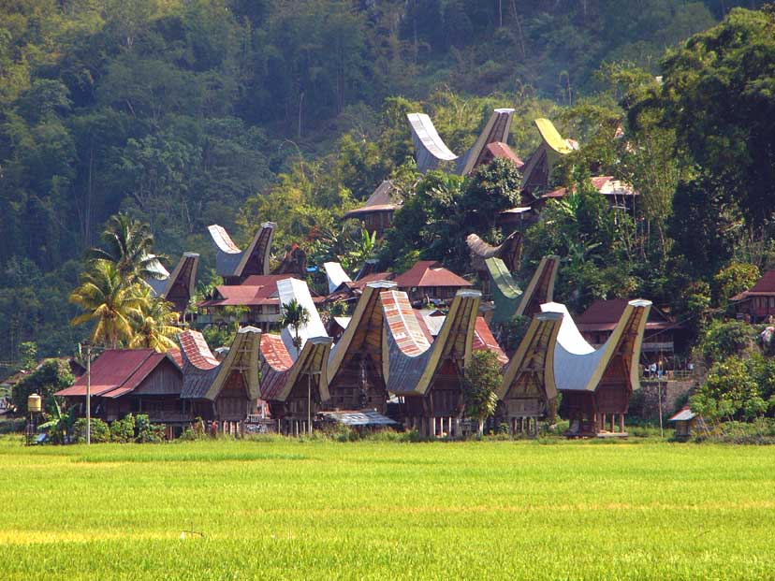
THANK YOU VERY MUCH

